Slide 1
Module - 5
Text Mining
Naïve-Bayesian Analysis Support Vector Machines
Web Mining
Social Network Analysis
Dr. S. NANDAGOPALAN, M. Tech., M.S., Ph. D

Slide 2
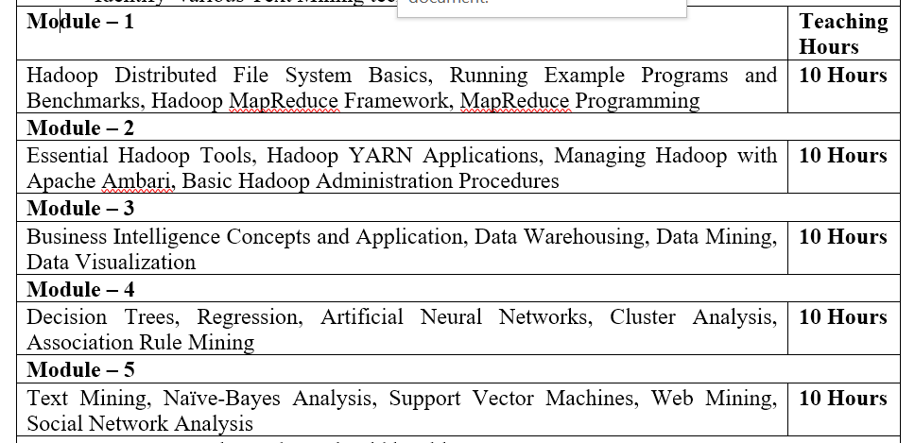
Syllabus

Slide 3

Text Book

Slide 4
Agenda
TEXT MINING
NAÏVE-BAYES ANALYSIS
SUPPORT VECTOR MACHINES
WEB MINING
SOCIAL NETWORK ANALYSIS
SUMMARY

Slide 5
TEXT MINING

Slide 6
Introduction
To discover knowledge, insights, and patterns from an organized collection of textual databases.
Helps to perform frequency analysis of important terms and their semantic relationships - TDM.
Text and images - Social media
Text mining can be applied to large-scale social media data for gathering preferences and measuring emotional sentiments.

Slide 7
Case Study : WhatsApp
Do you think that what you post on social media remains private? Think again.
A dashboard of conversations between two people Jennifer and Nicole over 45 days on whatsapp.
The waking hours of Jennifer, showing that she is most active around 8:00 p.m. and heads to bed around midnight.
Fifty-three percent of her conversation is about food, and 15 percent about desserts. Maybe she is a strategic person to push restaurant or weight loss ads.
WhatsApp is the world’s largest messaging service that has over 450 million users. FaceBook recently bought this 8 years ago for a whopping $19 billion.

Slide 8
Text – From Where?
In the legal profession: text sources would include law, court deliberations, court orders, and so on.
In academic research: it would include texts of interviews, published research articles, and so on.
The world of finance: will include statutory reports, internal reports, CFO statements, and many more.
In medicine: it would include medical journals, patient histories, discharge summaries, and so on.
In marketing: it would include advertisements, customer comments, and so on.
In the world of technology and search: it would include patent applications, the whole of information on the World Wide Web, and many more.

Slide 9
Text Mining Applications
Marketing
Anticipating and predicting consumer behavior through social media sources, such as reviews, blogs, tweets, etc.
The customer call center data can be analyzed for patterns of customer complaints.
Business operations
Social network analysis and text mining can be applied to e-mails, blogs, social media and other data to measure the emotional states and the mood of employee populations

Slide 10
Text Mining Applications...
Legal
Lawyers can more easily search case histories and laws for relevant documents
Case histories, testimonies, and client meeting notes can reveal additional information, such as comorbidities (co-occurrence of diseases) in a health care situation
Governance and politics
Measuring the emotional states and the mood of constituent populations (e.g. #MeToo)
Predict emerging threats
Analyze research trends - academics

Slide 11
Text Mining Applications...
Governance and politics
Lawyers can more easily search case histories and laws for relevant documents
Case histories, testimonies, and client meeting notes can reveal additional information, such as comorbidities (co-occurrence of diseases) in a health care situation
Business operations
Social network analysis and text mining can be applied to e-mails, blogs, social media and other data to measure the emotional states and the mood of employee populations

Slide 12
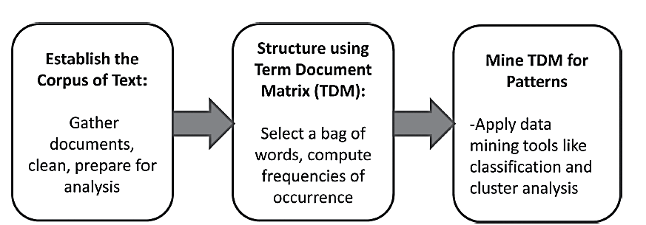
Text Mining Architecture

Slide 13
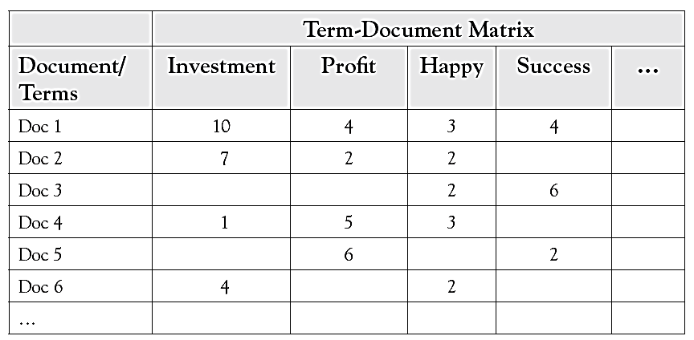
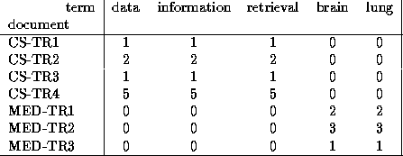
TDM

Slide 14
Creating TDM
The technique used for structuring the text is called the bag-of-words technique. This approach measures the frequencies of select important words and/or phrases occurring in each document
Creating a TDM requires making choices of which terms to include. The terms chosen should reflect the stated purpose of the text mining exercise.
A large collection of documents mapped to a large bag of words ill likely lead to a very large sparse matrix if they have few common words – Dimensionality reduction (SVD)
Synonyms - ?

Slide 15
Creating TDM…
Data should be cleaned for spelling errors. Common spelling errors should be ignored and the terms should be combined
Use only ‘stems’ –
customer order, ordering, and order => use single token word, called “order.”
On the other side, homonyms/polysemy (terms with the same spelling but different meanings) should be counted separately.
Eg. “The boss ordered that the customer data analysis be presented in chronological order.”
Terms with very few occurrences in very few documents should be eliminated from the matrix.
The cell value in TDM – frequency(f)/log(f)/f÷n/

Slide 16
Search Engine Concept
We have a collection of documents (mainly text or html-based)
We have a set of users
A user wants to retrieve the documents related to a given concept
He consequently submits a query expressed through words or terms
An information retrieval system returns the documents most related to this concept

Slide 17
Search Engine Concept…
How can we retrieve information using a search engine?.
We can represent the query and the documents as vectors (vector space model)
However to construct these vectors we should perform a preliminary document preparation.
The documents are retrieved by finding the closest distance between the query and the document vector.
Which is the most suitable distance to retrieve documents?

Slide 18
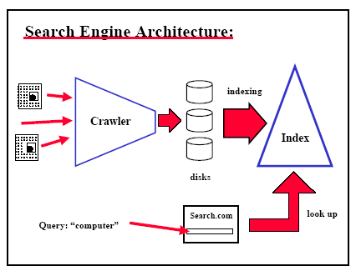
Search Engine Architecture

Slide 19
Document File Preparation
Manual Indexing
Relationships and concepts between topics can be established
It is expensive and time consuming
It may not be reproduced if it is destroyed.
The huge amount of information suggest a more automated system

Slide 20
Document File Preparation
Automatic indexing
To buid an automatic index, we need to perform two steps:
Document Analysis: Decide what information or parts of the document should be indexed
Token analysis: Decide with words should be used in order to obtain the best representation of the semantic content of documents.

Slide 21
Document Normalization
After this preliminary analysis we need to perform another preprocessing of the data
Remove stop words
Function words: a, an, as, for, in, of, the…
Other frequent words
Stemming
Group morphological variants
Plurals “ streets” -> “street”
Adverbs “fully” -> “full”
The current algorithms can make some mistakes
“police“, “policy” -> “polic”

Slide 22
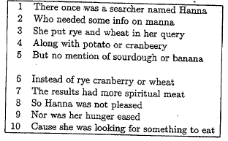
File Structures
Once we have eliminated the stop words and apply the stemmer to the document we can construct:
Document File
We can extract the terms that should be used in the index and assign a number to each document.

Slide 23
File Structures
Term | Global Frequency
banana | 1
cranb | 2
Hanna | 2
hunger | 1
manna | 1
meat | 1
potato | 1
query | 1
rye | 2
sourdough | 1
spiritual | 1
wheat | 2
Dictionary
We will construct a searchable dictionary of terms by arranging them alphabetically and indicating the frequency of each term in the collection

Slide 24
File Structures
Term | (Doc, Position)
banana | (5,7)
cranb | (4,5); (6,4)
Hanna | (1,7); (8,2)
hunger | (9,4)
manna | (2,6)
meat | (7,6)
potato | (4,3)
query | (3,8)
rye | (3,3);(6,3)
sourdough | (5,5)
spiritual | (7,5)
wheat | (3,5);(6,6)
Inverted List
For each term we find the documents and its related position associated with

Slide 25
Latent Semantic Model
Latent semantic models
These models try to capture some semantic information
For instance, if we introduce a query with "newborn", it would be nice if documents containing "baby" but not "newborn" are also retrieved
We say that words are semantically related when they are used in the same context
Semantic similarity: two words are semantically related if they occur in the same document
SVD – Solution to find this

Slide 26
LSI
Uses a mathematical technique called Singular Value Decomposition (SVD) to identify patterns in the relationships between the terms and concepts contained in an unstructured collection of text.
LSI is based on the principle that words that are used in the same contexts tend to have similar meanings.
A key feature of LSI is its ability to extract the conceptual content of a body of text by establishing associations between those terms that occur in similar contexts.

Slide 27
Dimensionality Reduction
T x D matrices are normally huge. How to reduce the dimension? Best method is Latent Semantic Indexing (LSI)
Singular Value Decomposition (SVD) is the backbone of LSI
SVD Definition:
A_{[n x m]} = U_{[n x r]} Λ _{[ r x r]} (V_{[m x r]})^{T}
A: n x m matrix (e.g., n documents, m terms)
U: n x r matrix (n documents, r concepts)
Λ: r x r diagonal matrix (strength of each ‘concept’) (r: rank of the matrix)
V: m x r matrix (m terms, r concepts)

Slide 28
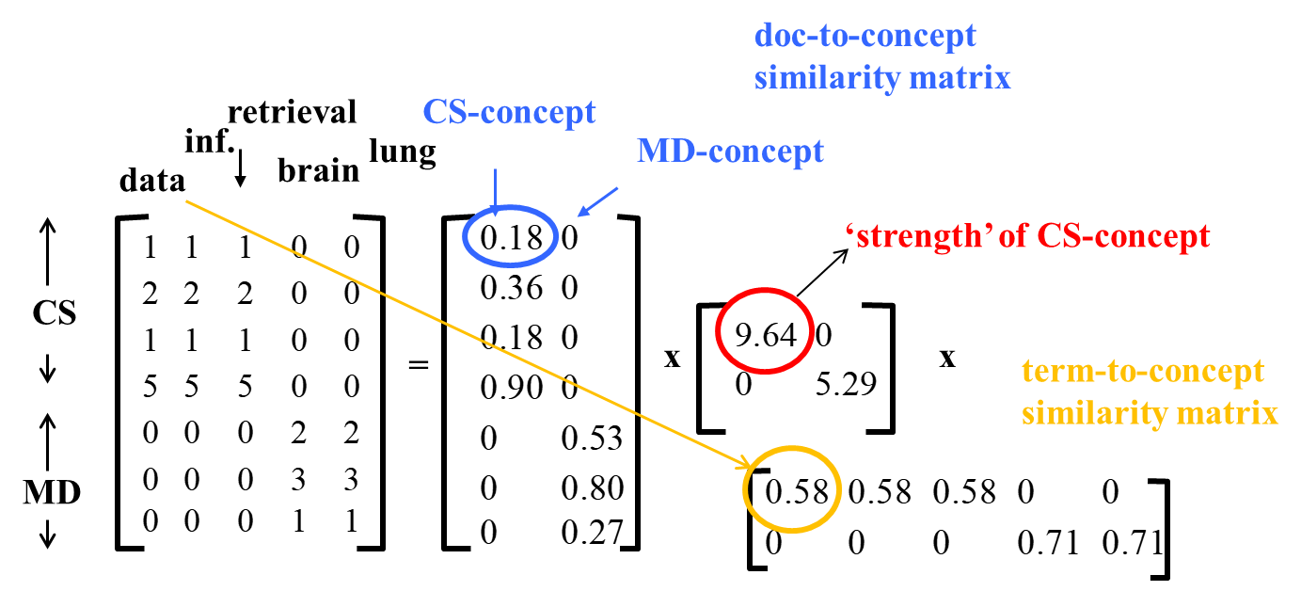
SVD - Example
‘documents’, ‘terms’ and ‘concepts’:
U: document-to-concept similarity matrix
V: term-to-concept similarity matrix
Λ: its diagonal elements: ‘strength’ of each concept
A = U Λ V^{T} - example:
d1 : Romeo and Juliet.
d2 : Juliet: O happy dagger!
d3 : Romeo died by dagger.
d4 : “Live free or die”, that’s the New-Hampshire’s motto.
d5 : Did you know, New-Hampshire is in New-England
Search query: dies, dagger.

Slide 29
SVD…
Clearly d3 should be ranked higher
What about d1 and d5?
d1 must be ranked higher than d5 ( d5 is not a matching document at all!)
The question is: Can the machine deduce this?
The answer is yes, LSI does exactly that.
In this example, LSI will be able to see that term dagger is related to d1 because it occurs together with the d1’s terms Romeo and Juliet, in d2 and d3, respectively.
Also, term dies is related to d1 and d5 because it occurs together with the d1’s term Romeo and d5’s term New-Hampshire in d3 and d4, respectively.

Slide 30
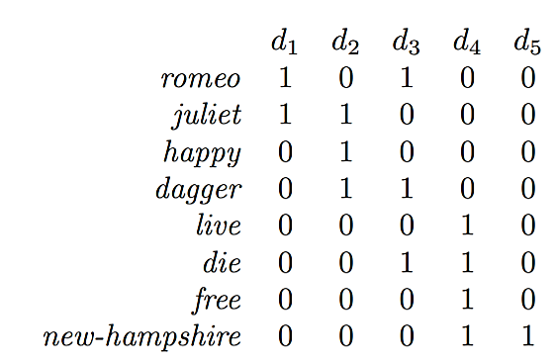
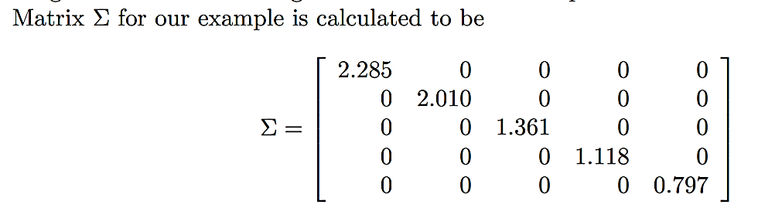
Example…

Slide 31
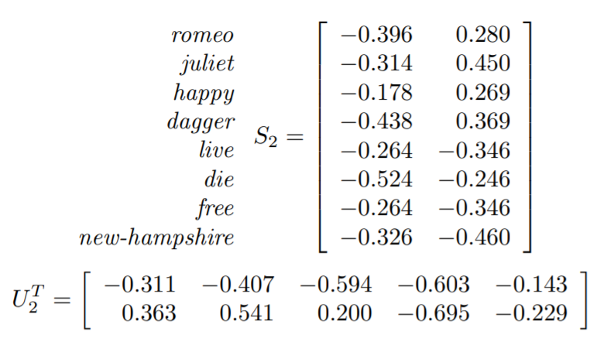
Example…
The terms in the concept space are represented by the row vectors of S₂ whereas the documents by the column vectors of U₂ ^{T}

Slide 32
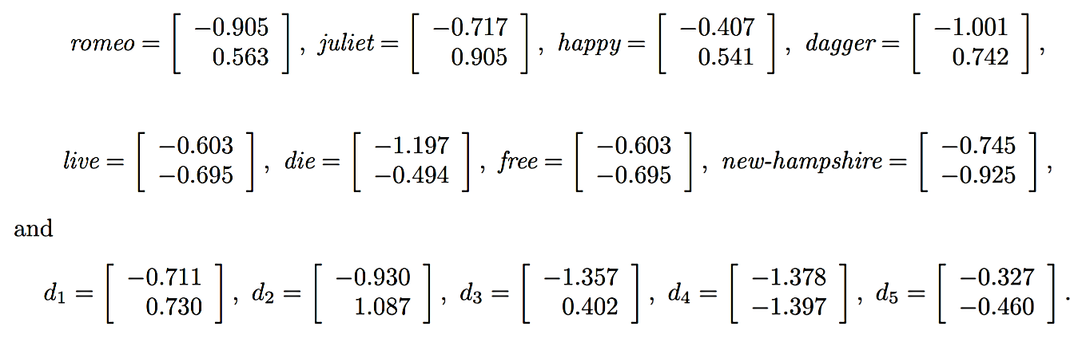
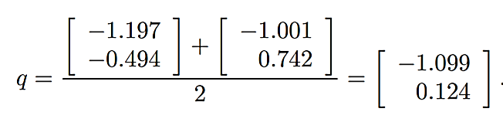
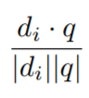
Contd…
Now the query is represented by a vector computed as the centroid of the vectors for its terms. In our example, the query is die, dagger and so the vector is
Finally, use cosine distance formula to find which documents are closer (i = 1 to n).

Slide 33
Mining the TDM
Regression analysis
Suppose the word profit is a desirable word in a document.
The number of occurrences of the word profit in a document could be regressed against many other terms in the TDM. Shows the impact of this word.
Classification
Predicting the chances of a document being liked – CEO/CFO
A decision tree could be constructed that makes a simple tree with a few decision points that predicts the success of a speech 80% of the time.

Slide 34
Mining the TDM…
Clustering
Categorize documents by common profile.
Cluster documents with words investment and profit.
Similarly, documents with words, customer orders and marketing, more often could be bundled together.
Association Rule Mining
Show relationships of coexistence
The words, tasty and sweet, occur together often - say 56% of the time

Slide 35
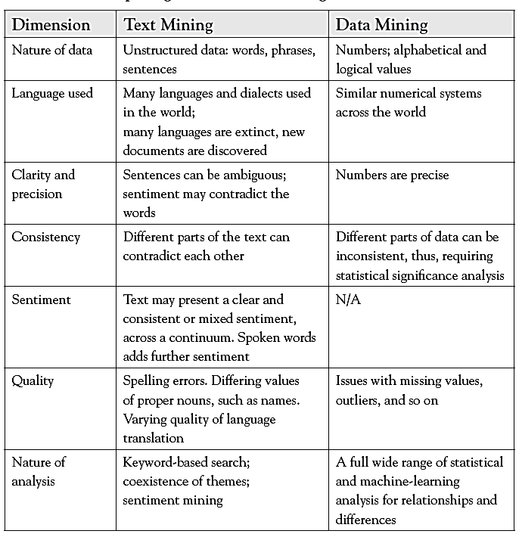
Text Mining Vs. Data Mining

Slide 36
Naïve-Bayesian Classification

Slide 37
Introduction
A statistical classifier: performs probabilistic prediction, i.e., predicts class membership probabilities
Foundation: Based on Bayes’ Theorem.
Performance: A simple Bayesian classifier, naïve Bayesian classifier, has comparable performance with decision tree and selected neural network classifiers
Incremental: Each training example can incrementally increase/decrease the probability that a hypothesis is correct — prior knowledge can be combined with observed data
Standard: Even when Bayesian methods are computationally intractable, they can provide a standard of optimal decision making against which other methods can be measured

Slide 38
Bayesian Theorem: Basics
Let X be a data sample (“evidence”): class label is unknown
Let H be a hypothesis that X belongs to class C
Classification is to determine P(H|X), the probability that the hypothesis holds given the observed data sample X
Probability that X will buy a computer given his age and income
P(H) (prior probability), the initial probability
E.g., X will buy computer, regardless of age, income, …
P(X): probability that sample data is observed
P(X|H) (posteriori probability), the probability of observing the sample X, given that the hypothesis holds
E.g., Given that X will buy computer, the prob. that X is 31..40, medium income

Slide 39
Bayesian Theorem
Given training data X, posteriori probability of a hypothesis H, P(H|X), follows the Bayes theorem
Informally, this can be written as
posteriori = likelihood × prior/evidence
Predicts X belongs to C₂ iff the probability P(C_{i}|X) is the highest among all the P(C_{k}|X) for all the k classes
Practical difficulty: require initial knowledge of many probabilities, significant computational cost

Slide 40
Towards Naïve Bayesian Classifier
Let D be a training set of tuples and their associated class labels, and each tuple is represented by an n-D attribute vector X = (x₁, x₂, …, x_{n})
Suppose there are m classes C₁, C₂, …, C_{m}.
Classification is to derive the maximum posteriori, i.e., the maximal P(C_{i}|X)
This can be derived from Bayes’ theorem
Since P(X) is constant for all classes, only
needs to be maximized

Slide 41
Derivation of Naïve Bayes Classifier
A simplified assumption: attributes are conditionally independent (i.e., no dependence relation between attributes):
This greatly reduces the computation cost: Only counts the class distribution
If A_{k} is categorical, P(x_{k}|C_{i}) is the # of tuples in C_{i} having value x_{k} for A_{k} divided by |C_{i, D}| (# of tuples of C_{i} in D)
If A_{k} is continuous-valued, P(x_{k}|C_{i}) is usually computed based on Gaussian distribution with a mean μ and standard deviation σ
and P(x_{k}|C_{i}) is

Slide 42
Exercise
Class
C1:buys_computer = ‘yes’
C2:buys_computer = ‘no’
Data sample
X = (age ≤ 30,
income = medium,
student = yes,
credit_rating = fair)
age | income | student | credit_rating | buys_computer
<=30 | high | no | fair | no
<=30 | high | no | excellent | no
31…40 | high | no | fair | yes
>40 | medium | no | fair | yes
>40 | low | yes | fair | yes
>40 | low | yes | excellent | no
31…40 | low | yes | excellent | yes
<=30 | medium | no | fair | no
<=30 | low | yes | fair | yes
>40 | medium | yes | fair | yes
<=30 | medium | yes | excellent | yes
31…40 | medium | no | excellent | yes
31…40 | high | yes | fair | yes
>40 | medium | no | excellent | no

Slide 43
Computation
 | Yes | No | Yes | No
P(Ci) | 9/14 | 5/14 | 0.643 | 0.357
P(X|Ci) |  |  | Prob. | Prob.
Age = youth | 2/9 | 3/5 | 0.222 | 0.6
Income = medium | 4/9 | 2/5 | 0.444 | 0.4
Student = yes | 6/9 | 1/5 | 0.667 | 0.2
Credit_rating = fair | 6/9 | 2/5 | 0.667 | 0.4
P(X|Ci) : P(X|buys_computer = “Yes”) = 0.222 x 0.444 x 0.667 x 0.667 P(X|buys_computer = “No”) = 0.6 x 0.4 x 0.2 x 0.4 |  |  | 0.044 | 0.019
P(X|Ci)*P(Ci) for “Yes” = 0.044*0.643 P(X|Ci)*P(Ci) for “No” = 0.019*0.357 |  |  | 0.028 | 0.019
So, X is classified as “YES”

Slide 44
Exercise – 2 : Text Classification
Data Set | Doc. ID | Keywords | Class = h (Healthy)
Training Data | 1 | Love Happy Joy Joy Love | Yes
 | 2 | Happy Love Kick Joy Happy | Yes
 | 3 | Love Move Joy Good | Yes
 | 4 | Love Happy Joy Pain Love | Yes
 | 5 | Joy Love Pain Kick Pain | No
 | 6 | Pain Pain Love Kick | No
Test Data | 7 | Love Pain Joy Love Kick | ?
Doc ID | Love | Happy | Joy | Kick | Pain | Good | Move | Class
1 | 2 | 1 | 2 | 0 | 0 | 0 | 0 | Yes
2 | 1 | 2 | 1 | 1 | 0 | 0 | 0 | Yes
3 | 1 | 0 | 1 | 0 | 0 | 1 | 1 | Yes
4 | 2 | 1 | 1 | 0 | 1 | 0 | 0 | Yes
5 | 1 | 0 | 1 | 1 | 2 | 0 | 0 | No
6 | 1 | 0 | 0 | 1 | 2 | 0 | 0 | No
Yes | 6 | 4 | 5 | 1 | 1 | 1 | 1 | 19
No | 2 | 0 | 1 | 2 | 4 | 0 | 0 | 9

Slide 45
Solution
 | Yes | No | Yes | No
P(Ci) | 4/6 | 2/6 | 0.666 | 0.333
P(X|Ci) |  |  | Prob. | Prob.
Love | 6/19 | 2/9 | 0.315 | 0.222
Pain | 1/19 | 4/9 | 0.052 | 0.444
Joy | 5/19 | 1/9 | 0.263 | 0.111
Love | 6/19 | 2/9 | 0.315 | 0.222
Kick | 1/19 | 2/9 | 0.052 | 0.222
P(X|Ci) : P(X|Healthy = “Yes”) P(X|Healthy = “No”) |  |  | 0.0000705 | 0.0005392
P(X|Ci)*P(Ci) for “Yes” = 0.044*0.643 P(X|Ci)*P(Ci) for “No” = 0.019*0.357 |  |  | 0.00004699 | 0.0001795
So, Doc. 7 is classified as “NO”

Slide 46
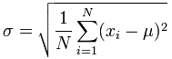
Example 2 (Continuous Data)
Normal distribution:
One for each (A_{i},c_{i}) pair
For (Income, Class=No):
If Class=No
sample mean = 110
sample variance = 2975
This is the formula for Standard Deviation:

Slide 47
Advantages & Disadvantages
It is Simple.
Conditional probabilities can be computed for discrete data and for probabilistic distributions.
NB assumes all features are independent. But this may be a limitation.
Even if the probability of one of the features is ZERO, then the entire computation leads to zero.
NB is not good for event happenings.

Slide 48
SVM

Slide 49
Introduction
SVM is a supervised learning model. It means you need a dataset which has been labeled.
Used for classification and regression.
In the case of SVM, it learns a linear model.
What is a linear model?
In simple words: it is a line (in complicated words it is a hyperplane).
If your data is very simple and only has two dimensions, then the SVM will learn a line which will be able to separate the data.

Slide 50
Introduction…
SVM uses hypothesis space of a linear functions in a high dimensional feature space.
It is trained with a learning algorithm from optimization theory that implements a learning bias derived from statistical learning theory.
Applications - hand writing analysis, face analysis and so forth.

Slide 51
Support Vector Machines
Find a linear hyperplane (decision boundary) that will separate the data

Slide 52
Support Vector Machines
One Possible Solution

Slide 53
Support Vector Machines
Another possible solution

Slide 54
Support Vector Machines
Other possible solutions

Slide 55
Support Vector Machines
Which one is better? B1 or B2?
How do you define better?

Slide 56
Support Vector Machines
Find hyperplane maximizes
the margin => B1 is better than B2

Slide 57
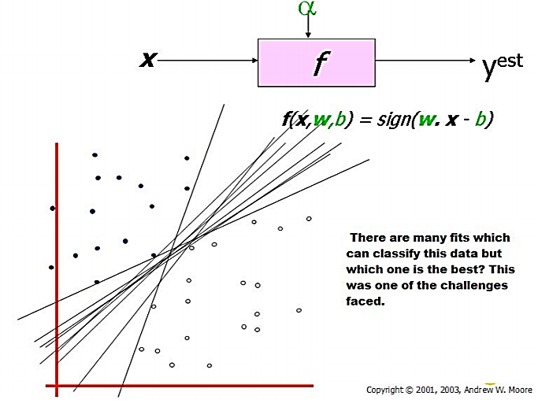
ANN vs. SVM

Slide 58
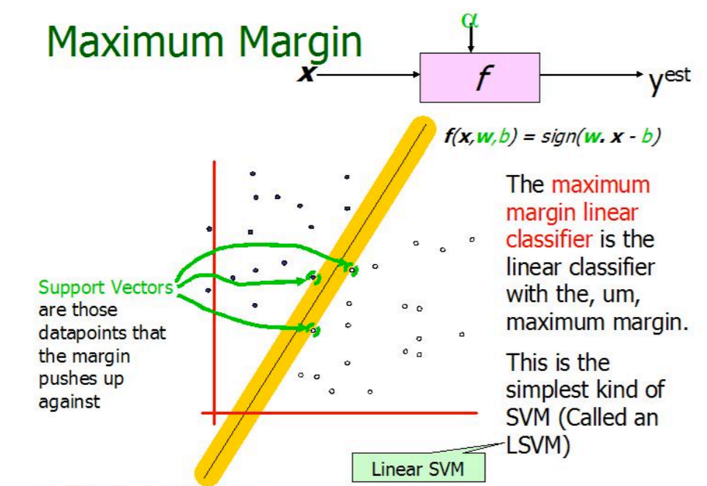
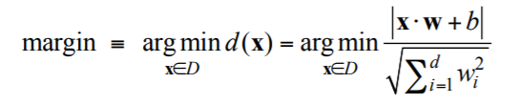
Maximum margin classifier

Slide 59
Goals of SVM
Separating the data with hyperplane and extend this to non-linear boundaries using kernel trick.
What is “Kernel trick”? What is feature space?

Slide 60
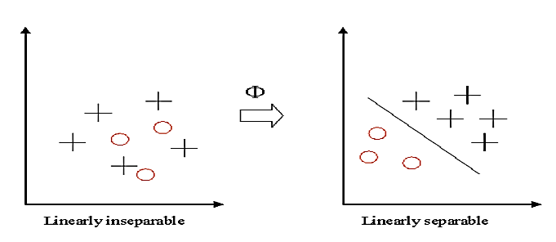
Kernel
If data is linear, a separating hyperplane may be used to divide the data.
However it is often the case that the data is far from linear and the datasets are inseparable.
To allow for this kernels are used to non-linearly map the input data to a high-dimensional space. The new mapping is then linearly separable.
This mapping is defined by the Kernel: K(x, y) = Φ(x) . Φ(y)

Slide 61
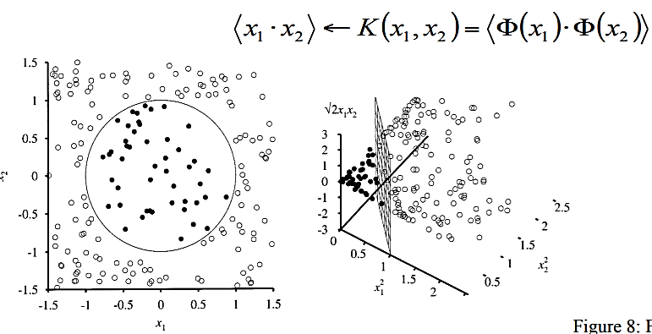
Feature Space
Transforming the data into feature space makes it possible to define a similarity measure on the basis of the dot product.
If the feature space is chosen suitably, pattern recognition can be easy

Slide 62
Steps for Kernel trick
when <w,b> is obtained the problem is solved for a simple linear scenario in which data is separated by a hyper plane.
The Kenral trick allows SVM’s to form nonlinear boundaries.
The algorithm is expressed using only the inner products of data sets. This is also called as dual problem.
Original data are passed through non linear maps to form new data with respect to new dimensions by adding a pair wise product of some of the original data dimension to each data vector.
Rather than an inner product on these new, larger vectors, and store in tables and later do a table lookup, we can represent a dot product of the data after doing non linear mapping on them. This function is the kernel function.

Slide 63
Advantages
Works well when no. of features is greater than no. of instances.
Its applicable for spam filtering where words are larger.
When the optimal decision boundary is nonlinear, SVM transforms the variable to create new dimensions such that it is linear in the transformed dimensions.
Easy to understand, computationally efficient.

Slide 64
Disadvantages
It works well for real numbers and the dataset should be numeric only.
Works for binary classification only.
Training takes more time.
When data has noise, it may not work properly.

Slide 65
Web Mining

Slide 66
Introduction
More data is posted on the Web every day than was there on the whole Web just 20 years ago.
Billions of users are using it every day for a variety of purposes.
The Web is used for ecommerce, business communication, and many other applications.
Web mining analyzes data from the Web and helps find insights that could optimize the web content and improve the user experience.
Data for web mining is collected via web crawlers, web logs, and other means.

Slide 67
Characteristics
Appearance: Aesthetic design; well-formatted content, easy to scan and navigate; and good color contrasts.
Content: Well-planned information architecture with useful content; fresh content; search-engine optimized; and links to other good sites.
Functionality: Accessible to all authorized users; fast loading times; usable forms; and mobile enabled.

Slide 68
Why Web Mining?
The structure are of interest to ensure that the Web is easy to use.
The analysis of web usage provides feedback on the web content and also the consumer’s browsing habits.
This data can be of immense use for commercial advertising, and even for social engineering.
The Web could be analyzed for its structure as well as content.
The usage pattern of web pages could also be analyzed

Slide 69
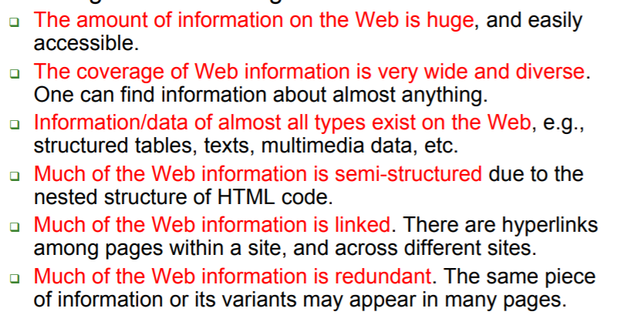
Challenges

Slide 70
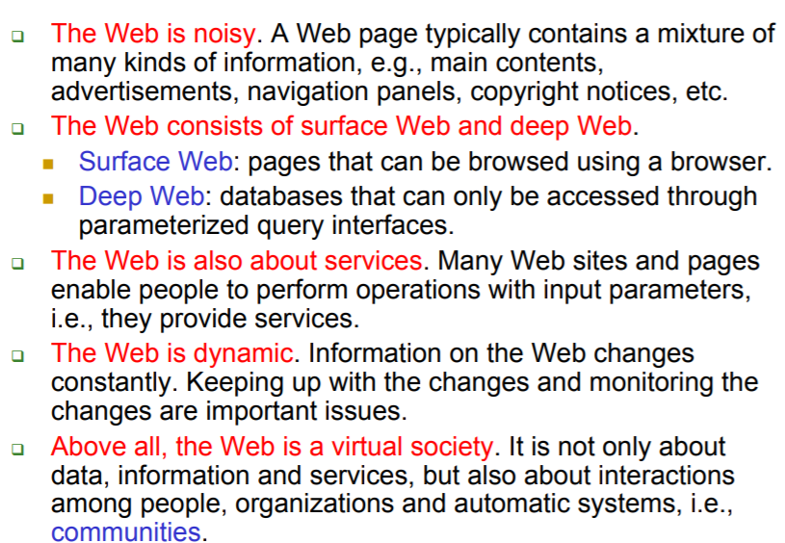
Challenges…

Slide 71
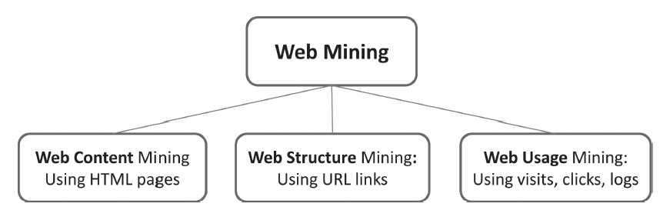
Web mining structure

Slide 72
Web Content Mining
Mining, extraction and integration of useful data, information and knowledge from Web page contents.
Wrapper induction
Automatic data extraction

Slide 73

Sample Web page - 1

Slide 74
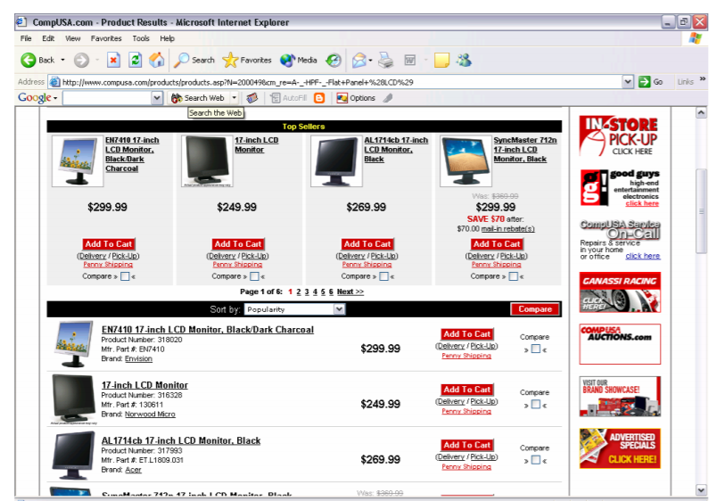
Sample Web page - 2

Slide 75
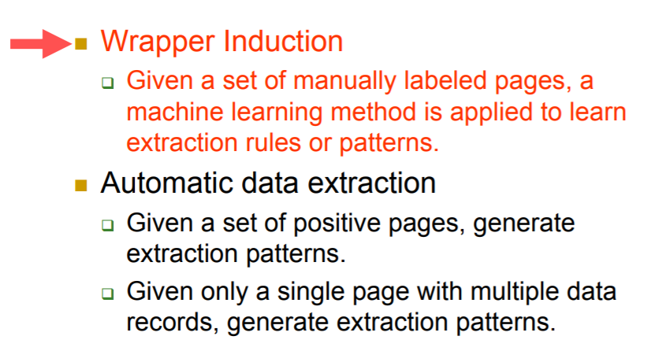
Road map

Slide 76
Wrapper Induction
Using machine learning to generate extraction rules.
The user marks the target items in a few training pages.
The system learns extraction rules from these pages.
The rules are applied to extract target items from other pages.
Many wrapper induction systems, e.g.,
WIEN (Kushmerick et al, IJCAI-97),
Softmealy (Hsu and Dung, 1998),
Stalker (Muslea et al. Agents-99),
BWI (Freitag and McCallum, AAAI-00),
WL2 (Cohen et al. WWW-02).
Thresher (Hogue and Karger, WWW-05)

Slide 77
Stalker: A hierarchical wrapper induction
Hierarchical wrapper learning
Extraction is isolated at different levels of hierarchy
This is suitable for nested data records (embedded list)
Each item is extracted independent of others.
Each target item is extracted using two rules
A start rule for detecting the beginning of the target item.
A end rule for detecting the ending of the target item.

Slide 78
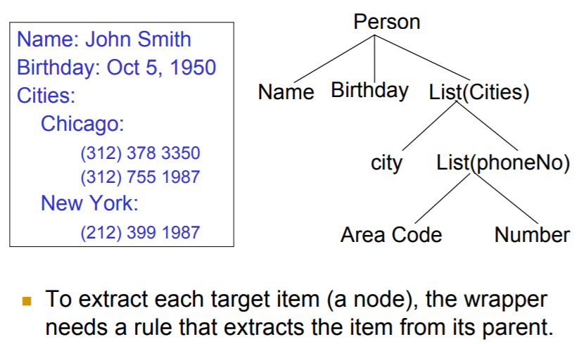
Hierarchical extraction based on tree

Slide 79
Limitations of Supervised Learning
Manual Labeling is labor intensive and time consuming, especially if one wants to extract data from a huge number of sites.
Wrapper maintenance is very costly:
If Web sites change frequently
It is necessary to detect when a wrapper stops to work properly.
Any change may make existing extraction rules invalid.
Re-learning is needed, and most likely manual relabeling as well.

Slide 80
Web Structure Mining
The Web works through a system of hyperlinks using the hypertext protocol (http).
Any page can create a link to any other page. The intertwined or self-referral nature of the Web lends itself to some unique analytical algorithms.
The structure of web pages could also be analyzed to examine the structure of hyperlinks among pages.

Slide 81
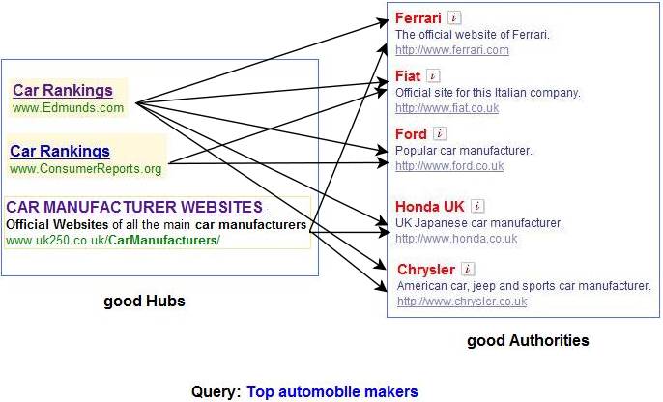
Hubs and Authorities

Slide 82

Strategic Models
Hubs
The pages with a large number of interesting links would serve as a hub, or a gathering point, where people access a variety of information.
Media sites like Yahoo.com or government sites would serve that purpose.
There are focused hubs like Traveladvisor.com and many websites which could aspire to become hubs for new emerging areas.

Slide 83
Strategic Models…
Authorities
Ultimately, people would gravitate toward pages that provide the most complete and authoritative information on a particular subject, including user reviews.
These websites would have the most number of inbound links.
Thus, Mayoclinic.com would serve as an authoritative page for expert medical opinion.
Tripadvisor serves for travel purpose.

Slide 84
Types of text mining
Keyword (or term) based association analysis
automatic document (topic) classification
similarity detection
cluster documents by a common author
cluster documents containing information from a common source
sequence analysis: predicting a recurring event, discovering trends
anomaly detection: find information that violates usual patterns

Slide 85
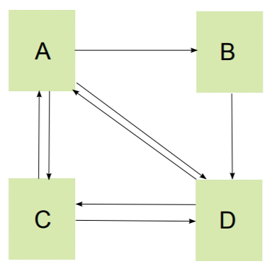
Web mining Algorithm: Page Ranking
There are four pages. Page A contains a link to page B, a link to page C, and a link to page D.
Page B contains one single link to page D. Page C points to pages A and D, and page D points to pages A and C.
They are represented by the following graph. We have L(A) = 3, L(B) = 1 and L(C) = L(D) = 2.

Slide 86
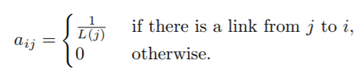
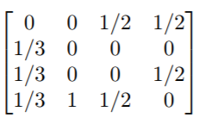
Page Ranking…
Let N be the total number of pages. We create an N × N matrix A by defining the (i, j)-entry as
L(A) = 3, L(B) = 1 and L(C) = L(D) = 2.
A B C D
A B C D

Slide 87
Method
Note that the sum of the entries in each column is equal to 1.
In general, a matrix is said to be column-stochastic if the entries are non-negative and the sum of the entries in each column is equal to 1.
The matrix A is by design a column-stochastic matrix, provided that each page contains at least one out-going link.
The simplified Pagerank algorithm is: Initialize x to an N ×1 column vector with non-negative components, and then repeatedly replace x by the product Ax until it converges.
We call the vector x the pagerank vector. Usually, we initialize it to a column vector whose components are equal to each other

Slide 88
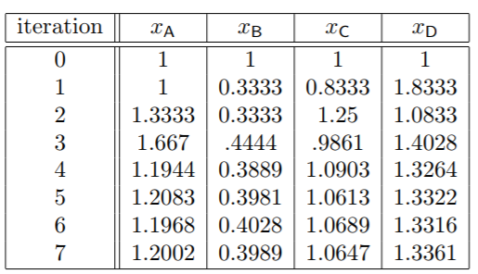
PageRank Vector
Page D has the highest rank

Slide 89
Web Usage Mining
As a user clicks anywhere on a web page or application, the action is recorded by many entities in many locations.
The browser at the client machine will record the click, and the web server providing the content would also log onto the pages-served activity.
The entities between the client and the server, such as the router, proxy server, or ad server, too, would record that click.

Slide 90
Goal
The goal of web usage is to extract useful information from data generated through web page visits and transactions.
The activity data comes from data stored in server access logs, referrer logs, agent logs, and clientside cookies.
The user characteristics and usage profiles are also gathered directly, or indirectly, through syndicated data.
Further, metadata, such as page attributes, content attributes, and usage data, are also gathered.

Slide 91
Uses
To create personalized Web-pages or provide enhanced search engines.
Extracting useful information from the Web usage statistics
To extract the patterns of information from web log data
Harvesting and processing data for the purpose of uncovering usage and navigation patterns of Web users.

Slide 92
Uses…
Association rules in the web usage mining are used to find relationships between pages that frequently appear next to one another in user sessions.
Ex: A.html, B.html => C.html
This rule shows, if user observes A and B pages, most likely will observe page C at the same meeting.
Sequential patterns are used to find user navigation patterns which appear frequently at meetings. A sequential pattern is often as follows:
70% of users who have first observed the page A.html and then page B.html, have observed page C,html in the same session , too.

Slide 93
Uses…
The server side analysis would show the relative popularity of the web pages accessed. Those websites could be hubs and authorities.
The client-side analysis could focus on the usage pattern or the actual content consumed and created by users
Usage pattern could be analyzed using “clickstream” analysis, that is, analyzing web activity for patterns of sequence of clicks, and the location and duration of visits on websites. Clickstream analysis is useful for web activity analysis, software testing, market research, and analyzing employee productivity.

Slide 94
Contd.
Textual information accessed on the pages retrieved by users could be analyzed using text mining techniques.
The text would be gathered and structured using the bag-of-words technique to build a term-document matrix.
This matrix could then be mined using cluster analysis and association rules for patterns, such as popular topics, user segmentation, and sentiment analysis

Slide 95
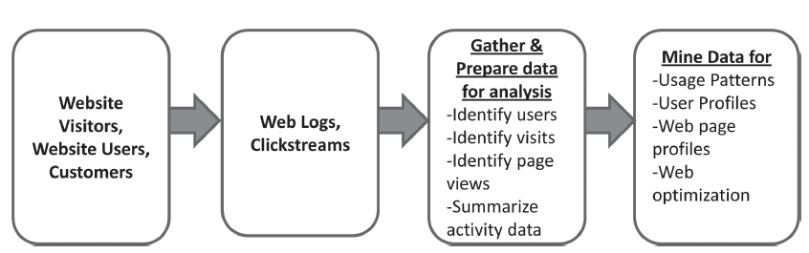
Web usage mining architecture

Slide 96
Web Mining Algorithms
Hyperlink-Induced Topic Search (HITS)
HITS identifies good authorities and hubs for a topic by assigning two numbers to a page: an authority and a hub weight
These weights are defined recursively. A higher authority weight occurs if the page is pointed to by pages with high hub weights.
A higher hub weight occurs if the page points to many pages with high authority weights.

Slide 97
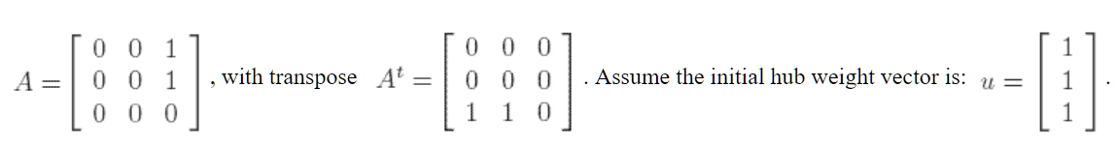
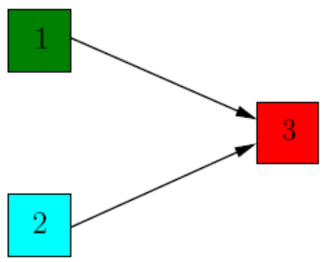
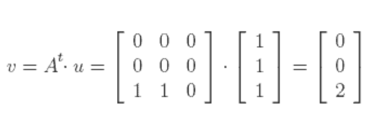
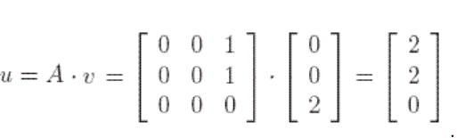
Example
authority weight vector
updated hub weight

Slide 98
Social Network Analysis
Play

Slide 99
Introduction
Social Networks are a graphical representation of relationships among people and/or entities.
SNA is used to discover the patterns of interaction and influence within in the participants in a network.
SNA will discover central nodes and subnetworks (cluster of nodes where connections are strong).
Strength of relationships is measured through iterative processes.

Slide 100
Applications of SNA
Self awareness: organize and support network
Communities: help identification, construction, and strengthening of network within communities
Marketing: organizations can reach out to communities. Understand customer needs. True for politicians too.
Public health: identify paths that certain diseases to spread. Helps public health dept.

Slide 101
Network topologies: Ring

Slide 102
Network topologies: Hub-Spoke

Slide 103
Techniques & Algorithms
Discovering Subnetworks

Slide 104
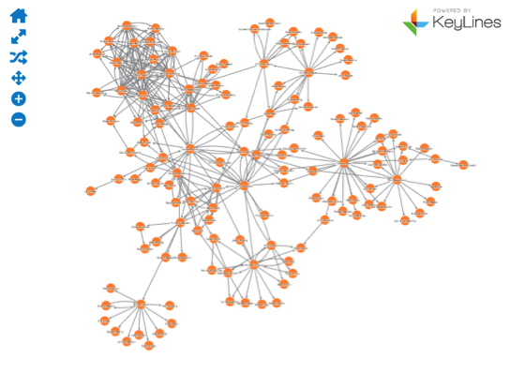
Case Study - Enron EMail
Network Topology

Slide 105
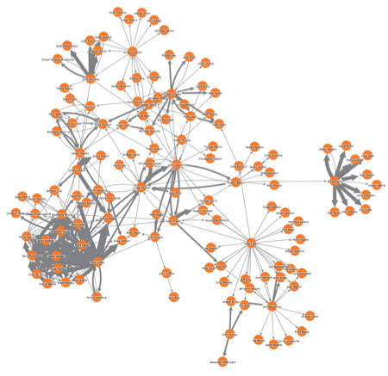
Email volume

Slide 106
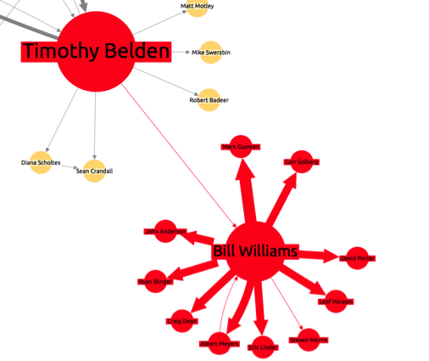
Using network links to trace connections
This shows that Bill is connected to the wider network through only one other person; Timothy Belden

Slide 107
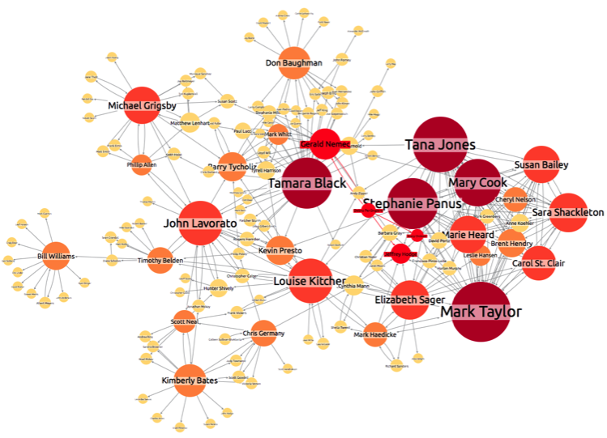
Degree centrality
Degree centrality is purely a measure of how many direct connections a person/node has.

Slide 108
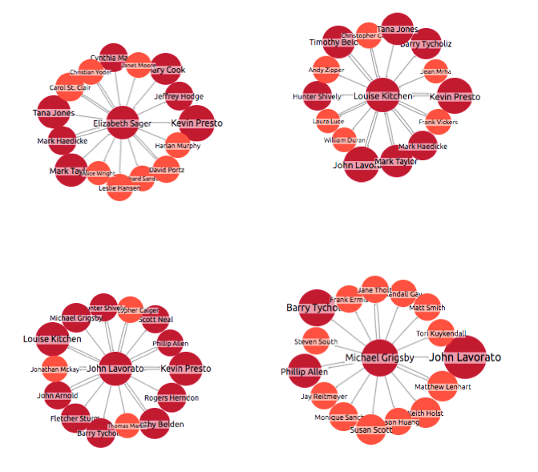
Closeness centrality

Slide 109
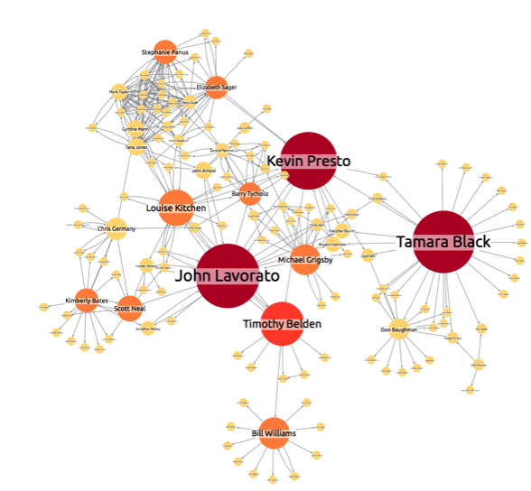
Betweenness Centrality
Betweenness measures how well a node connects separate communities within the network

Slide 110
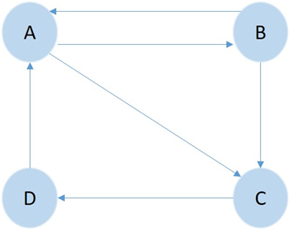
Techniques & Algorithms
Computing importance of Nodes
Consider the following simple network with 4 nodes (A, B, C, D) and 6 directed links between them.
Ra, Rb, Rc, Rd are Pageranks for the nodes.

Slide 111
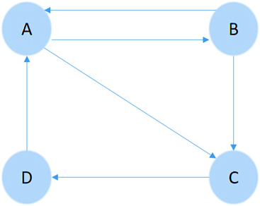
Influence Matrix
Ra = 1/L(B) x Rb + 1/L(D) x Rd
Rb = 1/L(A) x Ra
Rc = 1/L(A) x Ra + 1/L(B) x Rb
Rd = 1/L(C) x Rc
L(A)=2; L(B)=2; L(C)=1; L(D)=1
 | Ra | Rb | Rc | Rd
Ra | 0 | 0.5 | 0 | 1.0
Rb | 0.5 | 0 | 0 | 0
Rc | 0.5 | 0.5 | 0 | 0
Rd | 0 | 0 | 1.0 | 0

Slide 112
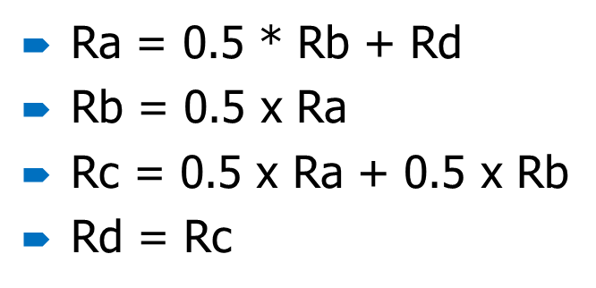
Computing Ranks
Begin with each R = ¼ = 0.25
Use influence Matrix to iteratively compute Ranks
R values will converge to final Ranks
Variable | InitVal | Iteration1 | Iteration2
Ra | 0.250 | 0.375 | 0.3125
Rb | 0.250 | 0.125 | 0.1875
Rc | 0.250 | 0.250 | 0.250
Rd | 0.250 | 0.250 | 0.250

Slide 113
Iteration 8
Page A has the highest Rank.
Variable | InitVal | Iteration1 | Iteration2 | Iteration8
Ra | 0.250 | 0.375 | 0.3125 | 0.333
Rb | 0.250 | 0.125 | 0.1875 | 0.167
Rc | 0.250 | 0.250 | 0.250 | 0.250
Rd | 0.250 | 0.250 | 0.250 | 0.250

Slide 114
Exercise
Compute the rank values for the following network:
A
B
E
D
C

Slide 115
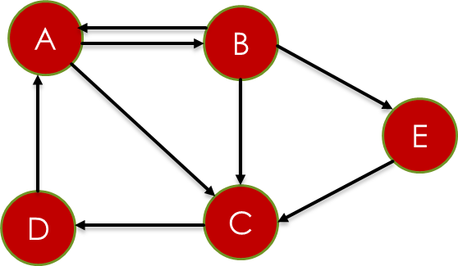
Influence Matrix/Flow Matrix
L(A)=2; L(B)=3; L(C)=1; L(D)=1; L(E)=1
i/j | Ra | Rb | Rc | Rd | Re
Ra | 0 | 0.33 | 0 | 1.0 | 0
Rb | 0.5 | 0 | 0 | 0 | 0
Rc | 0.5 | 0.33 | 0 | 0 | 1
Rd | 0 | 0 | 1.0 | 0 | 0
Re | 0 | 0.33 | 0 | 0 | 0
Ra = 0.33 * Rb + Rd; Rb = 0.5*Ra
Rc = 0.5 * Ra + 0.33 * Rb + Re; Rd = Rc;
Re = 0.33*Rb
L(A)=2; L(B)=3; L(C)=1; L(D)=1; L(E)=1

Slide 116
Rank Calculation
 | I1 | I2 | I3 | I4 | I5 | I6 | I7 | I8 | I9 | I10
Ra | 0.20 | 0.27 | 0.27 | 0.43 | 0.52 | 0.56 | 0.58 | 0.59 | 0.59 | 0.60
Rb | 0.20 | 0.20 | 0.20 | 0.20 | 0.20 | 0.20 | 0.20 | 0.20 | 0.20 | 0.20
Rc | 0.20 | 0.37 | 0.45 | 0.49 | 0.51 | 0.52 | 0.53 | 0.53 | 0.53 | 0.53
Rd | 0.20 | 0.20 | 0.37 | 0.45 | 0.49 | 0.51 | 0.52 | 0.53 | 0.53 | 0.53
Re | 0.20 | 0.20 | 0.20 | 0.20 | 0.20 | 0.20 | 0.20 | 0.20 | 0.20 | 0.20
Node A has highest rank

Slide 117
Summary

